Slide 1

SURROGATE CITY TOOL
SSAD_46
Akansha
Arushi
Ayush
Dhruva
Siddharth

Slide 2
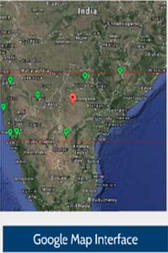

DESCRIPTION
Surrogate City Finder Tool is to find the weather data file of a city anywhere in the based on the Latitude, Altitude and Temperature given by the end-user from known data files.
This is a web application, which takes city name as input and displays the cities which has same climatic conditions.
Here the end-user may be Building energy simulation professionals, Researchers and HVAC Designers.
An Interactive World Map will be used as UI for making the existing weather files of all the cities anywhere in the world.

Slide 3

TOOL SCOPE
The User shall initially have to sign up to use the tool.
After signing up the user will give a city as input in the search bar.
Chosen city is displayed on the map along with all the available cities whose weather data files are available.
User can also filter the cities based on additional inputs.
Details of the city are to be extracted from Wikipedia.
Extracted details are compared with know data files.

Slide 4

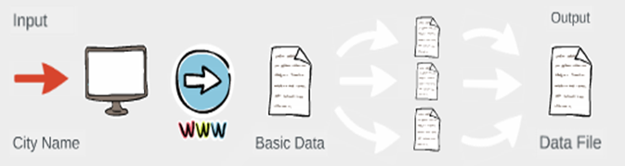
WORK FLOW
Firstly the user signs up for the website and logs in .
We take the city name and get the latitude and longitude of the inputted city from Wikipedia.
We then take the latitude ,Altitude, Average Temperature of all available weather files.
We then compare these details and select a appropriate weather data file.

Slide 5

Data Extraction and Comparison
Based on the city name Latitude, Longitude, Altitude and Average Temperature values are extracted from Wikipedia.
Extraction is done by parsing the page source.
These values are compared with all the weather data files available in the world.
We provide various filters to the user so that he/she can filter cities by Latitude range, Altitude range and temperature difference.
RMS error is calculated for input city and all available cities, and minimum valued city is chosen as the output.

Slide 6
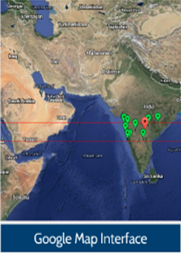
Graphical User Interface (GUI)
The Initial Page contains marking of all those cities whose weather data files exist on the Google Map.
User Interface contains input boxes along with a map interface to locate the cities and a navigation for guidance.
Basic information of the city is displayed. (data extracted from Wikipedia)
The Best 10 Surrogate Cities are displayed on the right hand side based on their RMS values.
Google Maps API is used.

Slide 7
Conclusion
Based on the known weather data files, we predict the weather data of other known cities.
We even get the data of rainfall humidity etc. from those weather data files.
These data would help us in designing a effective building without spending too many resources on the air-conditioning, wall insulation, lighting etc.
We can have a effective building plan.

